Slide 1
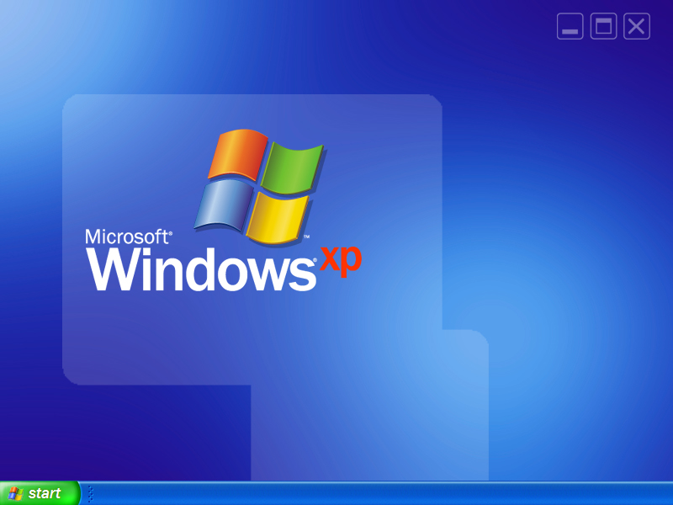
Windows for the Jedi:
Optimizing Windows XP
Tuning the performance of your
Windows XP Professional workstation
Kurt Shintaku
Principal Technology Specialist
Microsoft Los Angeles
Notes:
Tools are located at \\lan-usp-01\users\kurtsh\Public\Presentations\WindowsXPOptimization.

Slide 2

Forward
“I don’t feel in control of Windows”
  Reminisce about the days of…
    AUTOEXEC.BAT, CONFIG.SYS, HIMEM.SYS, EMM386.SYS, SMARTDRV.EXE
    WIN.INI, SYSTEM.INI
    QEMM, ODI drivers, NDIS drivers
  Windows for Workgroups 3.11 provided geeky levels of tweaking
    DOS, TCP/IP, INI files
It’s all there. The tools just changed.
  Regedit.exe, Services.msc, Resource Kit tools
  3rd party tools

Slide 3
Why did it get slow?
Non-optimal or default configuration
  Network designed for generic scenarios
  Video & disk drivers installed are usually generic
  Compatibility forever!
Higher average number of processes
  Growth in average process count due to installations
  SVCHOST.EXE processes growth
Conflicting execution threads
  Serial requests kill performance
Escalating bottlenecks
  Max disk efficiency is 50% used or less
  Every network I/O filter slows performance
  Memory usage at 80% always swaps system
Immediate performance > Operational efficiency
  Memory
  Disk
Notes:
Windows can’t conceivably clean up after every application re: temp files. It can’t make the disk fragmentation free – defrag processes take a LONG time and dynamic defragmentation slows normal file I/O to a halt. People are more interested in their workstation working quickly NOW NOW NOW and not interested in their workstation “operate efficiently to insure optimized long term performance”.
There are always constraints around hardware that is available. A hard drive that has 50% of it’s space free fragments at only a 1/10 of a drive that uses more than 50% of it’s space. A machine that has 256MB of memory will always swap OS System Kernel files out of memory and have to bring them back in. The number of combinations of network I/O devices and network types are too numerous to compensate for.
If an application uses memory, bandwidth, CPU, storage inefficiently there’s nothing anyone can do about it. Tools like Quicktime and Real Player are notorious for using enormous amounts of memory when they don’t need to.

Slide 4
What can we do about it?
OS Optimization
  Reducing boot time
  Reducing shutdown time
  System resource optimization
  Clearing Temp & History Files
Resource Performance Tuning
  Disk
  Network
  Memory
Application Performance Tuning
  Optimizing Internet Explorer
  Optimizing application execution
Cool Windows XP add-ons & tools

Slide 5
From the “duh” file
Things that should be looked into before anything else
Current drivers
  Updated BIOS firmware
  Updated adapter drivers
Disk considerations
  Always use NTFS; Never use FAT32.
  Indexing service: Just say no.
Display performance (Optional)
  Don’t use a desktop picture
  Minimize the number of icons on your desktop
  Disable themes

Slide 6
OS Optimization
Reducing Boot Time through Drivers & System Resources

Slide 7
Reduce boot time
Understand Windows boot
  What software is loading
  How long is each taking
Optimize what Windows loads at boot
  Remove unnecessary applications/utilities
  Disable unused hardware resources
  Uninstall unused Fonts
  Clean out the Prefetch cache
  Parallelize the boot sequence

Slide 8
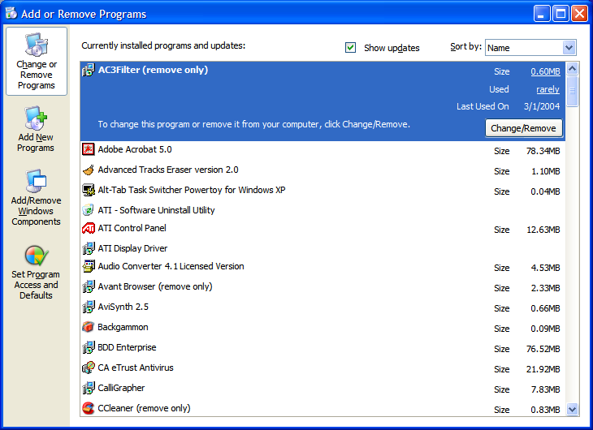
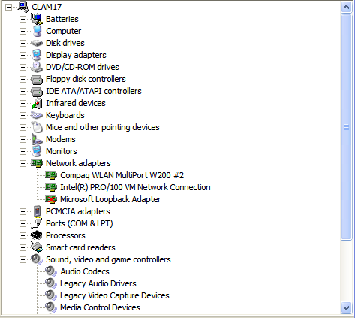
Removing apps/resources
Apps may load boot time stubs
  Quicktime
  Real
  Acrobat
Every hardware resource needs a driver & load time
  Serial or Parallel port? Onboard video? Onboard IDE/SCSI? USB? Firewire?
  Disable unneeded ports via BIOS

Slide 9

Uninstall unneeded fonts
Fonts increase boot time
  Loaded at boot
  Most people don’t know which fonts are useful
Tool: FontXplorer
  Visually displays fonts
  Determine which to keep or dump
  http://moonsoftware.com

Slide 10
Optimize boot sequence
TOOL: Bootvis.exe
  Logs every driver/service loaded at boot
  Clocks each for load time
  Provides “boot information intelligence”
    Enables analysis of software loaded
    Graphs time-to-load for each driver
    Auto-optimizes boot sequence for fastest performance; enables drivers to load in parallel
    (Note: Windows XP does this optimization operation 24 hours after installation automatically)
  http://download.microsoft.com/download/whistler/BTV/1.0/WXP/EN-US/BootVis-Tool.exe

Slide 11
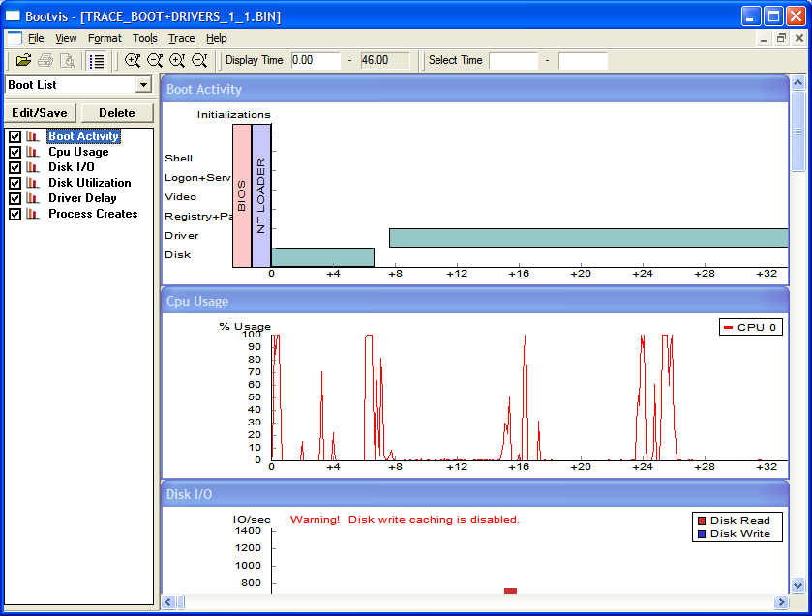
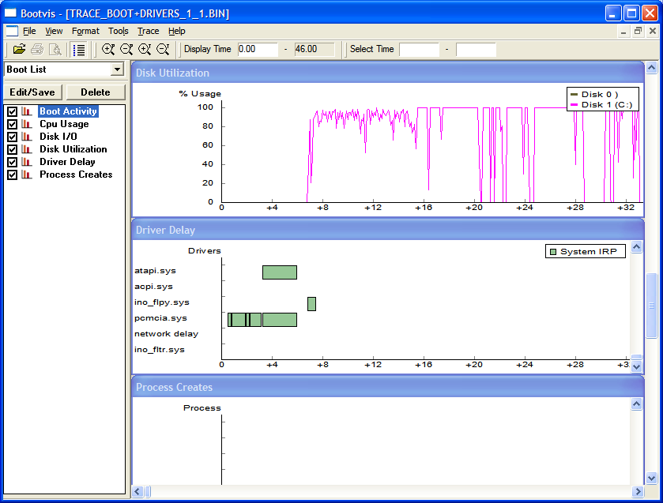
Parallelize boot sequence
TOOL: Bootvis.exe
  Logs every driver/service loaded at boot
  Times each load
  Analyzes software loaded in log
  Provides “boot intelligence”
    Enables viewing of software loaded
    Graphs time-to-load for each driver
    Auto-optimizes boot sequence for fastest performance (Some drivers load in parallel)

Slide 12
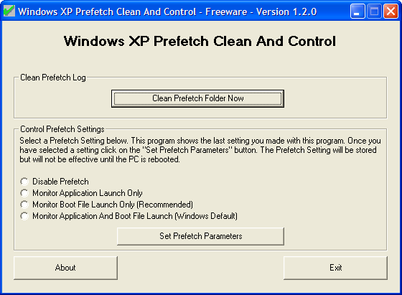
Tune the XP Prefetcher
Prefetcher can help or hurt performance
  Proactively loads apps during boot to improve load performance
Load apps at boot time
  Some apps have a '/prefetch:1' switch.
  Right click the shortcut and hit 'properties.‘
  In the 'target' box, put '/prefetch:1' at the end of the line. Press 'ok.'
Tool: Prefetch Cleaner
  Disable Prefetch
  Prefetch System only
  Prefetch Apps only

Slide 13
OS Optimization
Reducing Boot Time through the Registry

Slide 14
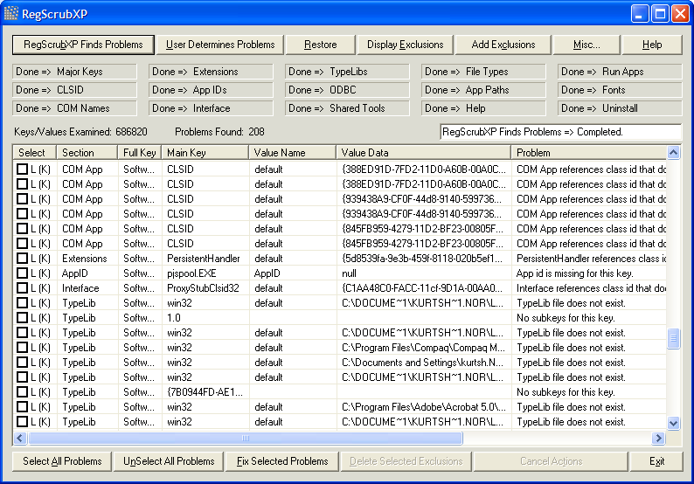
Clean the Registry
Registry = Database
  Useless data clogs the registry
  Requires more memory to load
  Increases boot time
  Slower application loads
Tool: Registry Scrubber - RegScrubXP.exe
  Remove left over, unreferenced values/keys
  http://www.majorgeeks.com/download.php?det=2048

Slide 15
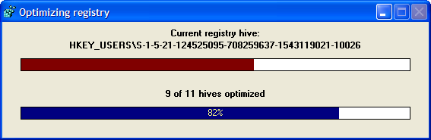
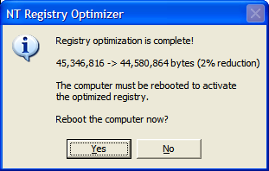
Compress the Registry
Expanded registry
  Requires more time to reference
  More space on disk
  More time at boot time
Tool: Registry Optimizer - NTRegOpt.exe
  Compresses the registry file – eliminates file space gaps
  http://home.t-online.de/home/lars.hederer/

Slide 16
OS Optimization
Reducing Boot Time through Services & Startup

Slide 17
Disable Unnecessary Services
Not all system services are necessary
  Use memory
  Increase boot time
  Slows the CPU down
Tool: Starter - Start.exe
  Know what programs run at “start”
  (Via the RUN registry key, Startup folder, etc.)
  Disable jobs that are unnecessary
  http://codestuff.mirrorz.com
Tool: Services Console - Services.msc
  Disable any of the 75+ services you don’t use
  Review http://www.blackviper.com for information about what each services does and why you do or do not need it.

Slide 18
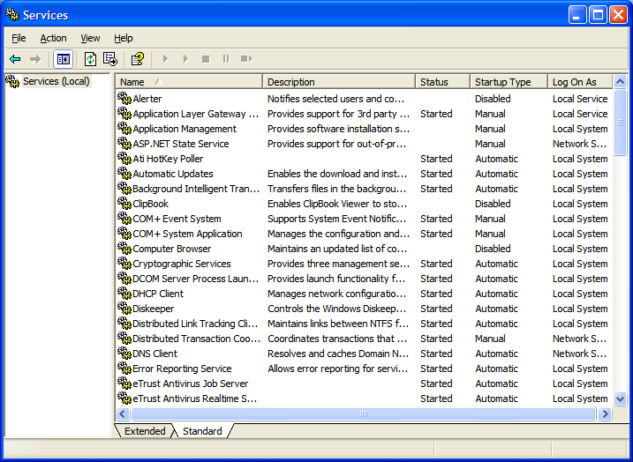
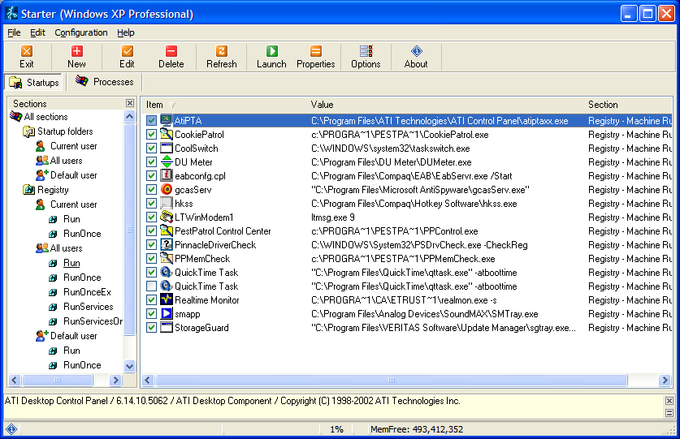
Disable Unnecessary Services

Slide 19
Summary
Reducing boot time
  Drivers, System Resources
    Bootvis
    Font Explorer
    Prefetch Cleaner
  Registry
    Registry Optimizer
    RegScrubXP
  Services
    Start Cleanup
    Services Console

Slide 20
OS Optimization
Reducing Shutdown Time

Slide 21
Reduce Shutdown Time
Shutdown times take longer
  Some apps or their dependencies don’t shutdown well; leave handles open to other resources
  Some profiles are cluttered
Tool: User Profile Hive Cleanup Service – UPHSetup.exe
  Closes handles left open by other apps that prevent logout
  Logs all applications run & handles opened
  Particularly good for roaming profiles
  http://www.microsoft.com/downloads/details.aspx?FamilyID=1b286e6d-8912-4e18-b570-42470e2f3582&displaylang=en

Slide 22
Reduce Shutdown times (through the Registry)
Applications are given time to shut down
  Current user - “Time to wait until killing apps”
    'HKEY_CURRENT_USER\Control Panel\Desktop\‘
    Highlight the 'WaitToKillAppTimeout' value.
    Set it to '1000' (the default should be 20000).
    Highlight the 'HungAppTimeout' value.
    Set it to '1000' also.
  All users - “Time to wait until killing apps”
    'HKEY_USERS\.DEFAULT\Control Panel\Desktop‘
    Highlight the 'WaitToKillAppTimeout' value.
    Set it to '1000' (the default should be 20000).
  System - “Time to wait until killing services”
    'HKEY_LOCAL_MACHINE\System\CurrentControlSet\Control\'
    Highlight the value 'WaitToKillServiceTimeout'
    Change this value to '1000.'

Slide 23
Summary
Reducing shutdown time
  User Profile Hive Cleanup
  Allocated shutdown timeout values
    User
    All users
    System

Slide 24
Resource Performance Tuning
Disk Performance

Slide 25
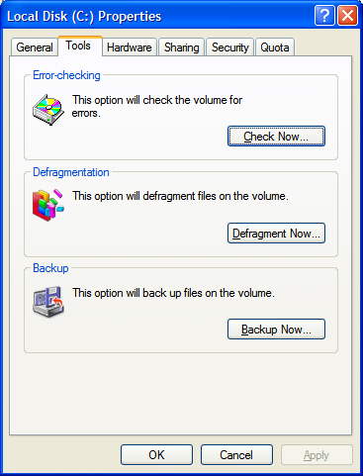
Error check your hard drives
Disk Errors = SLOW performance
  Simple jarring of desktop chassis
  Defragmenting will not help
Tool: Disk Error Checking
  Open 'my computer.'
  Right click the hard disk you wish
  to check and select 'properties.'
  Choose the 'tools' tab
  Under 'error checking'
  select the 'check now…' button.
  Check both options.
Disk will be checked for errors upon reboot
  May take hours depending on disk size

Slide 26
Disk Defragmentation
#1 Biggest Bottleneck in Performance
  Registry access
  Page file swapping
  System files
  Event log I/O
  Applications/data
    Outlook 2003 .OST/.PST files
    Project .MPP fils
What does defragmentation do?
  Organizes files for max read/write time
  DEFRAG.EXE does an “okay” job on normal files
Why do we need this with NTFS?
  Using more than 50% of disk?
  Locked system files
    Most commonly used
    Most commonly fragmented

Slide 27
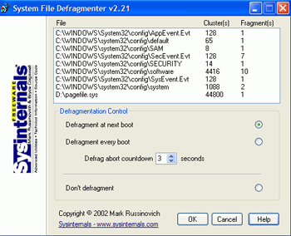
Tools for System File Defrag
DEFRAG.EXE is incomplete
  Locked system files
  WXPDefrag misses:
    Event Logs
    SAM
    System Executables
    Registry
    Pagefile
Tool: Pagedfrg.exe
  FREE - Defrags system files after reboot
  To use in tandem with built-in DEFRAG.EXE
  Not remotable/schedulable or very fast, no support
  http://www.sysinternals.com/ntw2k/freeware/pagedefrag.shtml

Slide 28
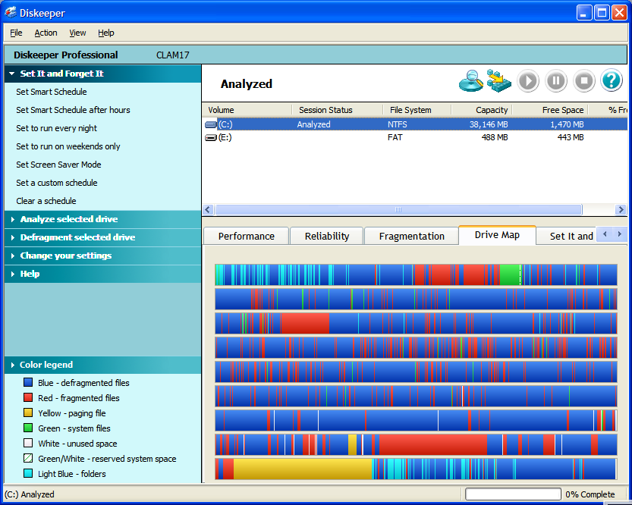
Tools for System File Defrag
Upgrade DEFRAG.EXE
  Tool: Diskeeper 9.0
  Executive Software
  “Enterprise” version of
  Pagedfrg.exe
  http://www.execsoft.com
  (Acct Rep: Rachel Jackson
  rjackson@execsoft.com)
Enterprise Defragmentation
  4x-8x faster than DEFRAG.EXE
  Remotely manageable
  Smart Schedule detection or ‘Screen saver’
  Laptop battery/power management-aware
  Adjustable system priority
  Safe & Enterprise Supported

Slide 29
Disable NTFS Last Access Update
Stop the 'last access update' stamp
  Directory FAT entries written to on every access
  Writes “Last access” time stamp to every folder
  Significant impact on hierarchical folder structures
NTFS update can be disabled through the registry:
  Open REGEDIT
  Navigate to: HKEY_LOCAL_MACHINES\System\CurrentControlSet\Control\FileSystem
  Create new DWORD value called 'NtfsDisableLastAccessUpdate'
  Set the value to '1'

Slide 30
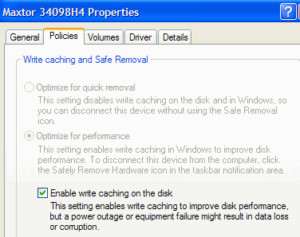
Enable write caching
Write caching improves write latency
  May be turned on already
  Disk response on writes can be 2x-4x faster
  Warning: Not for USB drives, or hot-swappable media
    May delay disk write before removal causing disk corruption
To enable write caching:
  Right click on my computer.
  Select 'properties.'
  Select the hardware tab, then
  ‘Device Manager.'
  From Device Manager:
    Expand 'disk drives'
    Highlight your hard disk
    Select 'properties'
    Select 'policies' tab.
  Or Control Panel - System –
  Hardware - Device Manager
  --> Disk Drives: <Drive>:
  Policies, Enable write caching

Slide 31
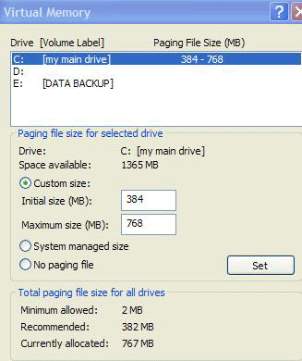
Move the Page File
What is the Page File?
  Drive area reserved for use as virtual memory
  Used when data exceeds physical memory (RAM)
Cool! Uh, right?
  No! Page file access is extremely slow. Avoid paging.
  Should be as “contiguous” as possible.
  Should always be accessible
“Two spindle” Optimization
  Move the page file to hard drive
  other than the System drive
  Can improve performance by 100%
How to:
  Right click on 'my computer'
  Select 'properties.'
  Select the 'advanced' tab.
  Under 'performance' choose
  'settings' button.
  Select the 'advanced' tab again
  Under 'virtual memory' select
  'change.'

Slide 32
Resource Performance Tuning
Network Performance

Slide 33
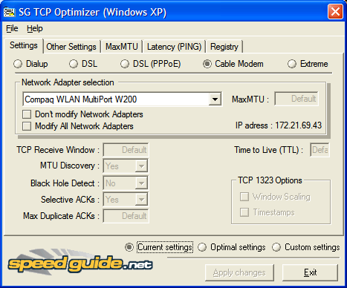
TCP Optimization
Network performance is suboptimal by default
  Generic parameters are used
  Dialup = DSL = 10Mbps
Tool: TCPOPT.EXE
  Settings are per Adapter
  Optimal MaxMTU
    Cable modem or DSL = 1500
    DSL PPPoE = 1492
    Dialup = 576
  TCP Receive Window
    General Values
      Extreme = 513920
      Cable modem
      or DSL = 256960
      DSL PPPoE = 255552
      Dialup = 65392
MaxConnections per Server = 20

Slide 34
HIDDEN:
Tuning your Network Adapter
(The extreme way with Cablenut)
The next step in the tweaking process is to get all of the software that is needed. The main software program that you will use is called CableNut, which is developed by CableNut Software and is available for free at www.cablenut.com. CableNut is a great program that allows users to edit their Internet settings easily. Visit their Web page and download and install the latest copy. Once you have downloaded CableNut, you are ready to start getting information to use with the program. The first value that you will need to calculate is the latency of your connection when it is active. To do this, you will use the trace route command built into Windows XP. Follow these steps to get the latency value to use for your connection:
First, open up a Command Prompt window. This can be done by clicking the Start Menu and selecting Run. Then type cmd in the text box and click the OK button.
Once Command Prompt is loaded, you are ready for the next part. Because you will need to test your connection when it is active, you will need to find something large to download that will run the duration of the test, which will be approximately 30 seconds. I recommend that you head over to www.microsoft.com/downloads and find some huge file, such as the .NET SDK framework, which is over 100,000 KBs. For the test, you want a file big enough so it will be downloading throughout the whole test. Those of you on a dialup connection can pick a much smaller file than those on a high-speed connection.
Once you have your download test file picked out, start the download and switch back to the Command Prompt window. In that window, type tracert www.tweakxp.com. During the test, you will see many times displayed in milliseconds. After the test finishes, pick the highest time, as shown in Figure 11-12. This is the number that you will use as your latency. Also, feel free to cancel the download after the test is finished.
Now that you have the latency value calculated, you are ready to enter this information into a great online CableNut settings calculator written by Joe Zeiler, who is one of the talented moderators at the TweakXP.com support forums. Open up your Web browser and visit www.j79zlr.com/cablenutXP2k.php (the URL is case-sensitive!), then follow these steps to get the values to enter into CableNut:
Once you have opened up the site, the first part of using the settings calculator is to select your connection type from the drop-down box.
Next, you will have to do a little research and find out exactly what your upload and download speeds should be for your Internet connection. I had to contact Comcast, my ISP, to find out the exact values, because the values are not always advertised. Once, you get those values, make sure that they are in kilobits per second and not kilobytes per second (KB= kilobytes; Kb= kilobits), then enter them in the corresponding text boxes on the Web page.
Enter the latency value that you calculated earlier into the latency text box on the Web page and then click the Calculate button.
After you hit the Compute Settings button, scroll down and you will see the values that were calculated. Now, you are almost done. Continue scrolling down until you see a button labeled CCS File Generator under the Cablenut setting files section. Click that button and a new window will pop up with some text in it. Make sure that you have any pop-up blockers disabled when you are using the calculator.
Use the mouse and select all of the text and numbers that are displayed in the pop-up window. Right-click the mouse and select copy to copy all of the text on the page to the clipboard.
Now open up Notepad from the Accessories folder. In the blank Notepad window, paste the contents of the clipboard by right-clicking the white background and selecting Paste.
Once Notepad is displaying the information that you copied from the pop-up window, all that is left is to save the file in the CableNut format. To do this, click the File menu bar item and select Save As. Then in the Save As Type drop-down box, select All Files. Key in myCableNutSettings.ccs in the file name text box. Specify the Save location, such as the desktop, and click the Save button.
You are now finished with the calculations that will optimize your Internet connection. That wasn't too hard now, was it? Now that you have created your CableNut settings file, or will be using the 56K settings file, you are ready to start using CableNut. Follow these steps to import the new optimized settings into your system:
Start up the CableNut application by opening the Start Menu and browsing to the CableNut folder and selecting the adjuster application.
When CableNut has loaded, click the File menu bar item and select Open Custom Settings File. Navigate to where you saved your settings file, or if you are a 56K user, use the file that is on the companion CD, called 56K_CableNut.ccs, and then click the Open button.
Now you will see the information boxes for all of the different parameters filled with your connection-specific information, as sh
Notes:
The next step in the tweaking process is to get all of the software that is needed. The main software program that you will use is called CableNut, which is developed by CableNut Software and is available for free at www.cablenut.com. CableNut is a great program that allows users to edit their Internet settings easily. Visit their Web page and download and install the latest copy. Once you have downloaded CableNut, you are ready to start getting information to use with the program. The first value that you will need to calculate is the latency of your connection when it is active. To do this, you will use the trace route command built into Windows XP. Follow these steps to get the latency value to use for your connection:
First, open up a Command Prompt window. This can be done by clicking the Start Menu and selecting Run. Then type cmd in the text box and click the OK button.
Once Command Prompt is loaded, you are ready for the next part. Because you will need to test your connection when it is active, you will need to find something large to download that will run the duration of the test, which will be approximately 30 seconds. I recommend that you head over to www.microsoft.com/downloads and find some huge file, such as the .NET SDK framework, which is over 100,000 KBs. For the test, you want a file big enough so it will be downloading throughout the whole test. Those of you on a dialup connection can pick a much smaller file than those on a high-speed connection.
Once you have your download test file picked out, start the download and switch back to the Command Prompt window. In that window, type tracert www.tweakxp.com. During the test, you will see many times displayed in milliseconds. After the test finishes, pick the highest time, as shown in Figure 11-12. This is the number that you will use as your latency. Also, feel free to cancel the download after the test is finished.
Now that you have the latency value calculated, you are ready to enter this information into a great online CableNut settings calculator written by Joe Zeiler, who is one of the talented moderators at the TweakXP.com support forums. Open up your Web browser and visit www.j79zlr.com/cablenutXP2k.php (the URL is case-sensitive!), then follow these steps to get the values to enter into CableNut:
Once you have opened up the site, the first part of using the settings calculator is to select your connection type from the drop-down box.
Next, you will have to do a little research and find out exactly what your upload and download speeds should be for your Internet connection. I had to contact Comcast, my ISP, to find out the exact values, because the values are not always advertised. Once, you get those values, make sure that they are in kilobits per second and not kilobytes per second (KB= kilobytes; Kb= kilobits), then enter them in the corresponding text boxes on the Web page.
Enter the latency value that you calculated earlier into the latency text box on the Web page and then click the Calculate button.
After you hit the Compute Settings button, scroll down and you will see the values that were calculated. Now, you are almost done. Continue scrolling down until you see a button labeled CCS File Generator under the Cablenut setting files section. Click that button and a new window will pop up with some text in it. Make sure that you have any pop-up blockers disabled when you are using the calculator.
Use the mouse and select all of the text and numbers that are displayed in the pop-up window. Right-click the mouse and select copy to copy all of the text on the page to the clipboard.
Now open up Notepad from the Accessories folder. In the blank Notepad window, paste the contents of the clipboard by right-clicking the white background and selecting Paste.
Once Notepad is displaying the information that you copied from the pop-up window, all that is left is to save the file in the CableNut format. To do this, click the File menu bar item and select Save As. Then in the Save As Type drop-down box, select All Files. Key in myCableNutSettings.ccs in the file name text box. Specify the Save location, such as the desktop, and click the Save button.
You are now finished with the calculations that will optimize your Internet connection. That wasn't too hard now, was it? Now that you have created your CableNut settings file, or will be using the 56K settings file, you are ready to start using CableNut. Follow these steps to import the new optimized settings into your system:
Start up the CableNut application by opening the Start Menu and browsing to the CableNut folder and selecting the adjuster application.
When CableNut has loaded, click the File menu bar item and select Open Custom Settings File. Navigate to where you saved your settings file, or if you are a 56K user, use the file that is on the companion CD, called 56K_CableNut.ccs, and then click the Open button.
Now you will see the information boxes for all of the different parameters filled with your connection-specific information, as sh

Slide 35
Optimizing Networking:
Increase DNS cache size
DNS Cache saves queries
  Cached DNS queries saved for finite time
  Bumped to make room for new addresses
Increase DNS cache to eliminate DNS lookups
  Open REGEDIT and navigate to; 'HKEY_LOCAL_MACHINE\SYSTEM\CurrentControlSet\Services\Dnscache\Parameters'
  Create the following DWORD values:
    CacheHashTableBucketSize = 1
    CacheHashTableSize = 180
    MaxCacheEntryTtlLimit = ff00
    MaxSOACacheEntryTtlLimit = 12d
  Exit and restart

Slide 36
Optimizing Networking:
Don’t cache failed DNS entries
DNS Cache saves failed queries
  Good cached DNS queries saved for finite time
  Failed DNS entries are stored for 5 minutes
Prevent unsuccessful DNS lookup caching
  Open REGEDIT and navigate to: 'HKEY_LOCAL_MACHINE\SYSTEM\CurrentControlSet\Services\Dnscache\Parameters'
  Create the following DWORD values:
    NegativeCacheTime= 0
    NetFailureCacheTime= 0
    NegativeSOACacheTime= 0
  Reboot for the changes to take effect.

Slide 37
Resource Performance Tuning
Memory Performance

Slide 38
Keep Windows Operating Data in Main Memory
Windows System Services swap to Page File
  Takes time to save/retrieve to/from disk
  Does this whether or not system is low on physical RAM
Disable Windows System paging
  If you have 256MB of system memory or more, force Windows to keep its operating data in main memory
  Open Regedit.
  Navigate to HKEY_LOCAL_MACHINE\SYSTEM\ControlSet001\Control\Session Manager\Memory Management.
  Select the DisablePagingExecutive value to '1'

Slide 39
Force DLL Unload
Applications load DLLs that linger
  Dynamic Link Libraries contain data or functions
  Applications call DLLs
  Windows XP cache DLLs in memory for faster access
  DLLs use memory AFTER applications close
Force Windows XP to unload DLLs on Application exit
  To do this, first run REGEDIT.
  Navigate to HKEY_LOCAL_MACHINE\SOFTWARE\Microsoft\Windows\CurrentVersion\Explorer.
  Create a new key named 'AlwaysUnloadDLL‘
  Set the default value to equal '1.'
Notes:
Dynamic Link Libraries, or DLLs, are files containing data or functions that Windows programs can call when needed by linking to them. Every piece of windows software will include instructions to the operating system as to which DLLs it will need to access, and XP will cache these particular files in memory for faster access.
The trouble is, Windows XP keeps these DLLs cached after the relevant program has closed, wasting memory space. While DLLs are generally tiny, enough of them can make a dent, so it's worthwhile to implement this registry tweak, which will force Windows XP to unload DLLs used by a specific program when that program halts.
To do this, first run REGEDIT.
Navigate to HKEY_LOCAL_MACHINE\SOFTWARE\Microsoft\Windows\CurrentVersion\Explorer.
reate a new key named 'AlwaysUnloadDLL' and set the default value to equal '1.'

Slide 40
Resource Performance Tuning
Operating System Performance

Slide 41
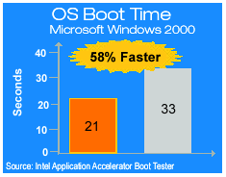
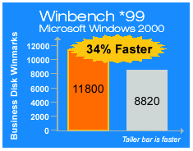
Intel App Accelerator
Intel “Disk Accelerator”
Benefits
  58% Faster Boot Time
  (Accelerated OS Load Time)
  Accelerated Disk I/O (WinBench 34% faster)
  High performance data fetcher
Requirements
  Intel Chipset Software Install Utility
  Older Intel chipset (pre-865)
  Intel Pentium 3, 4, Celeron, Xeon
What it does
  Replaces the WXP ATA (hard disk and IDE device) drivers with ones specially designed for Intel chipsets,
  Improve disk performance and boot time.
Notes:
Supported Chipsets
The Intel® Application Accelerator supports the following Intel® chipsets:
Intel® 810 Chipset
Intel® 810E Chipset
Intel® 810E2 Chipset
Intel® 815 Chipset
Intel® 815E Chipset
Intel® 815EP Chipset
Intel® 815P Chipset
Intel® 820 Chipset
Intel® 820E Chipset
Intel® 840 Chipset
Intel® 845 Chipset
Intel® 850 Chipset
Intel® 860 Chipset
-------------------------------
DOWNLOAD: http://www.intel.com/support/chipsets/iaa/
-------------------------------
Intel Application Accelerator
Make your PC go appreciably faster for free thank to Intel
A major performance bottleneck on a PC is fetching data from the hard drive, much of the time your processor is waiting around for new data to arrive. Intel, bless them, have looked at this and come up with a efficient new driver for your ATA interface which replaces Microsoft’s Windows driver. All your IDE drives will benefit, including ATAPI CD-ROM and DVD drives and even removeable drives.
Among the features are a data pre-fetcher for Pentium 4s, automatic selection of the best DMA transfer mode and support for drives of over 137GB. You can also mix DMA transfer modes on the same IDE channel. It comes replete with a diagnostic utility and plenty of documentation. It has been pretty thoroughly tested and has passed through Microsoft’s Hardware Quality Labs.
The results, according to Intel figures, are pretty impressive. On a Pentium 4 system boot time is 58 per cent faster and even more impressively, the Winbech 99 figures are 34 per cent faster, nice. If there is a catch we can’t see one.

Slide 42
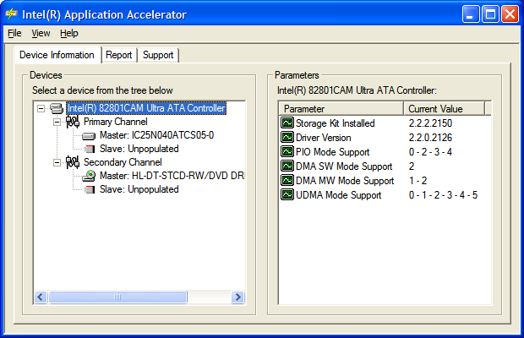
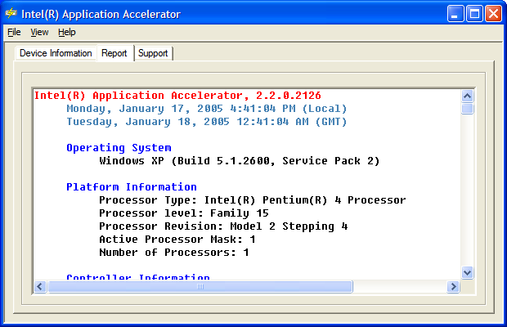
Intel App Accelerator
Caveat
  Affects ATA drives only
  Latest IAA v2.3 not supported on Mobile Processor (Use v2.2)
Notes:
Supported Chipsets
The Intel® Application Accelerator supports the following Intel® chipsets:
Intel® 810 Chipset
Intel® 810E Chipset
Intel® 810E2 Chipset
Intel® 815 Chipset
Intel® 815E Chipset
Intel® 815EP Chipset
Intel® 815P Chipset
Intel® 820 Chipset
Intel® 820E Chipset
Intel® 840 Chipset
Intel® 845 Chipset
Intel® 850 Chipset
Intel® 860 Chipset
-------------------------------
DOWNLOAD: http://www.intel.com/support/chipsets/iaa/
-------------------------------
Intel Application Accelerator
Make your PC go appreciably faster for free thank to Intel
A major performance bottleneck on a PC is fetching data from the hard drive, much of the time your processor is waiting around for new data to arrive. Intel, bless them, have looked at this and come up with a efficient new driver for your ATA interface which replaces Microsoft’s Windows driver. All your IDE drives will benefit, including ATAPI CD-ROM and DVD drives and even removeable drives.
Among the features are a data pre-fetcher for Pentium 4s, automatic selection of the best DMA transfer mode and support for drives of over 137GB. You can also mix DMA transfer modes on the same IDE channel. It comes replete with a diagnostic utility and plenty of documentation. It has been pretty thoroughly tested and has passed through Microsoft’s Hardware Quality Labs.
The results, according to Intel figures, are pretty impressive. On a Pentium 4 system boot time is 58 per cent faster and even more impressively, the Winbech 99 figures are 34 per cent faster, nice. If there is a catch we can’t see one.

Slide 43
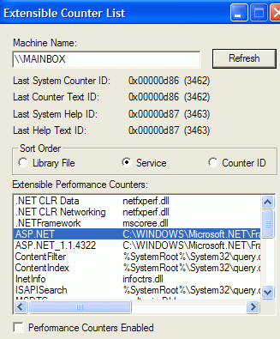
Disable Performance Counters
Windows XP Monitors Performance by Default
  Perf Counters report on CPU, Memory, Network, Page Swap, etc.
  Eats CPU; runs during every operation on PC
  Take up System Resources
  Most people don’t NEED performance counters on
Disable the Performance Counters
Tool: Extensible Performance Counter List
  Used to permanently disable these performance counters.
  Download and install the utility
  Run the Exctrlst.exe utility
  (found in 'c:\program files\resource kit\‘)
  Select each line in the 'Extensible performance counters' window
  Clear the 'performance counters enabled' button below.
  Perfmon will have no information available to it.
http://www.microsoft.com/windows2000/techinfo/reskit/tools/existing/exctrlst-o.asp

Slide 44
Set Performance setting in System
Ctrl-Panel → System → Advanced → Performance
  Animate windows when minimizing and maximizing
  Fade or slide menus into view
  Fade or slide tooltops into view
  Fade out menu items after clicking
  Show shadows…

Slide 45
Summary
Disk performance
  Scan your disk for logical/physical errors
  System & Page File Defrag/Diskeeper
  Enable write caching
  Move the Page file from the System drive
  Registry
    Disable NTFS Last Update
Network performance
  TCP Optimizer
  Registry
    Increase DNS Cache
    Don’t cache DNS failed entries
Memory utilization & performance
  BlackViper & Services.msc
  Registry:
    Keep Kernel in Memory
    Force Application DLL unloading from Memory
OS resource optimization
  Enable Intel Application Accelerator
  Disable Performance Counters
  Unset Performance checkboxes in CtrlPanel-System

Slide 46
Hardware Adjustments
Video/Memory Latency & Why enabling everything is evil

Slide 47
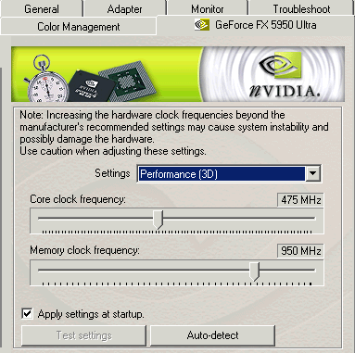
Video Adapter Overclocking: nVidia
Windows XP Driver package has Hidden Overclocking
Activate overclocking in Nvidia cards:
  Open REGEDIT
  Navigate to 'HKEY_LOCAL_MACHINE\Software\NVIDIA Corporation\Global\NVTweak'
  Create a new DWORD value called 'Coolbits' and give it a value of '3'
  Reboot.
“Cool bits” - 'clock frequency' page
  Adjust the GPU and memory clock speeds
    Allow the drivers to test them
    Just a test for stability, not guarantee of overclock
  ‘Auto detect' button
    Determine the recommended level of overclocking
    Use of this feature generally results in slightly conservative settings
    Changes will be applied automatically upon pressing 'ok.'

Slide 48
Video Adapter Overclocking: nVidia
WARNING:
Thermal Safeguard
  Will actually slow themselves down to avoid damage from excessive heat
  Overclocking the card of course produces more heat- safeguard may kick in
  The safeguard will still be in effect until the card gets a proper chance to cool down a bit (by rebooting, for example.)
Use the 'apply settings at startup' checkbox

Slide 49
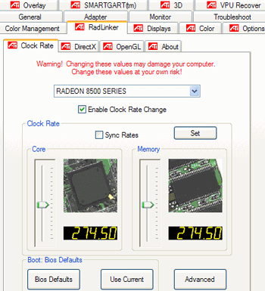
Video Adapter Overclocking:
ATI
No Overclocking feature in Windows XP drivers
  3rd party software is necessary - Radlinker utility, Plugin
To overclock an ATI video card with Radlinker:
  Install the program.
  Go to 'start\control panel\display' and select the 'settings' tab then hit 'advanced.
  Select the 'Radlinker' tab.
  Check the 'enable clock rate change' box. The sliders below are now enabled, allowing you to overclock the memory and processor speed.
  Click the set button to set the desired rate, then benchmark the card.
  Once you have an acceptable overclock, use the 'use current' button below to apply the changes every time you boot.

Slide 50

Change Memory Latency Times
  Latency = ‘Turnaround' time of your memory
    How long it takes for the memory to prepare to send and receive data.
    Lower latency equal better system performance
    Lowering times puts stress on your memory
  Facts about Memory
    Higher the rating, the higher its latency will be.
    Memory designed for overclocking have higher latency settings than 'normal' memory.
  Significant latency settings for modern DDR memory
  (listed here in order of significance)
    CAS (Column Address strobe) Latency: The time between a data request and the data being made available.
    RAS-to-CAS latency: Delay incurred by activating a new 'row' of memory addresses to read from. More important for DDR memory.
    RAS precharge: How long a row of memory is held 'open' (powered) so that data can be read from it.
    ACT to precharge delay: I have no idea.
  More info:
    http://www.pcstats.com/articleview.cfm?articleID=873

Slide 51
Disable unneeded ports
Do you really use your serial port?
Parallel port? That’s what I thought.
Disabling unneeded ports in BIOS
  Streamlines boot
  Improves performance
  Easy to reverse
Look in the 'integrated peripherals' section of the BIOS to find your ports and disable them.

Slide 52
Cleaning up the System
DLLs, Temp files, & Turds

Slide 53
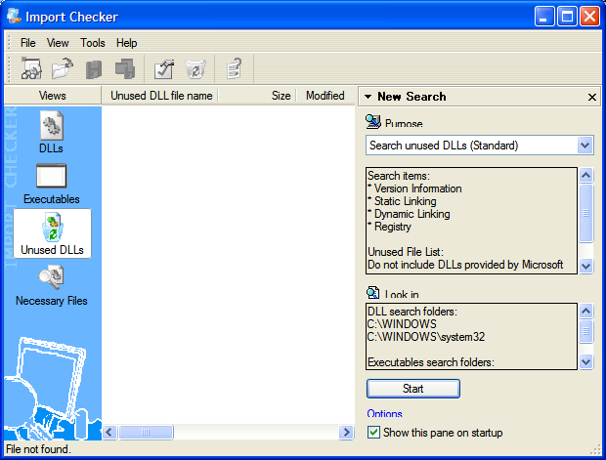
Remove unused DLLs
Unnecessary DLLs are bad
  Clog registry
  Can slow system
Question:
How do you know
what DLLs are needed?
Tool: DLLTOYS
  Diligently checks all DLL dependencies between registered libraries and applications
  Lists & removes unnecessary/orphaned DLL registrations
  Warning: This is an overnight process!

Slide 54
Delete Temp Files
Temp files lurk all over
  IE cache, cookies
  Memory dumps
  Application temp directories
  Histories, partial downloads
  Log files
  Chkdisk fragments
  Clipboard
  Recycle Bin
  Prefetch data
  Multiple Profiles!
Tool: CCLEANER.EXE
  Automagically cleans out every directory
  Includes 3rd party application (Adobe, Netscape, Real)
  Saves desired cookies

Slide 55
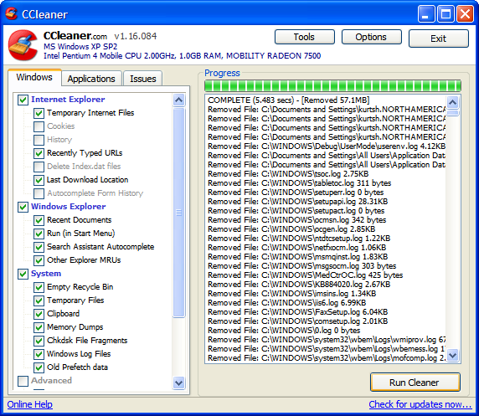
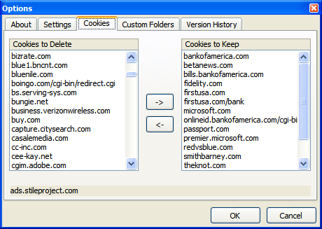
Delete Temp Files

Slide 56
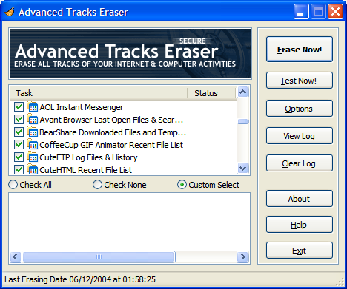
Cover Your Tracks
Paranoid?
  Think of all the
  programs that keep
  your usage histories
  besides IE and WMP
  Bearshare, CuteFTP,
  AOL IM, Acrobat, DiVX,
  FlashGet, KaZaa, ICQ,
  iMesh, Netscape, Opera,
  PowerDVD, WinZip,
  Trillian, ULead, etc.
Clean up after yourself
Tool: Advanced Tracks Eraser
  Clears Microsoft & 3rd party applications
  Cleans up ever login/logoff
  Cleans up every 2 minutes
  Cleans up with multiple overwrites

Slide 57
Summary
Hardware Adjustments
  Video overclocking
  Adjust Memory Latency
  Disable ports
Cleaning up the system
  DLLToys
  CrapCleaner
  Advanced Tracks Eraser

Slide 58
Other
Optimizing Internet Explorer
  HOST blocker - http://www.mvps.org/winhelp2002/hosts.txt
  Avant Browser – http://www.avantbrowser.com
  Maxthon – http://www.maxthon.com
  FlashGet – http://www.amazesoft.com/
  MSN Toolbar Suite (http://sandbox.msn.com)
  How to Repair/Reinstall Internet Explorer (Q318378)
  IE Download Limit Fix
Optimizing application execution
  PDF SpeedUp
Cool add-ons & tool for Windows XP
  SP2 Wireless Connectivity Fix (Q884020)
  SP2 Connection Limit Fix (http://www.LvlLord.de)
  DUMeter – http://www.dumeter.com
  DVDGenie – http://www.inmatrix.com
  RM.EXE (Bad Filenames)
  Diskpie – http://www.zornsoftware.com
  FreeRAM – http://www.bysoft.com
  Windows XP Powertoys http://www.microsoft.com/windowsxp/downloads/powertoys/xppowertoys.mspx
  Screensavers
    Bluescreen, Aquarium, Bliss, 3D WinXP, etc.
Notes:
Optimizing Internet Explorer
HOST blocker - http://www.mvps.org/winhelp2002/hosts.txt
Avant Browser
Maxthon
FlashGet
IE Download Limit Fix
MSN Toolbar Suite
How to Repair/Reinstall Internet Explorer
Optimizing application execution
PDF SpeedUp
Cool add-ons & tool for Windows XP
SP2 Wireless Connectivity Fix
SP2 Connection Limit Fix
DUMeter
DVDRegionChanger
Screensavers
Diskpie
RM.EXE (Bad Filenames)

Slide 59

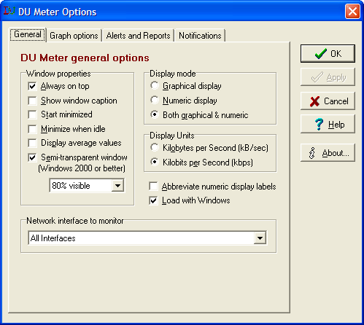

Slide 60
Resources
CDROM: Kurt’s Optimization Toolkit
  Contains all software referenced here
  Also available at:
  http://www.evilkoala.org/download/optimizingWinXP.zip
DOC: “Beginner’s Guide to Speeding Up Windows XP”
  A summary document with many of the improvements mentioned here
  Also available at:
  http://www.evilkoala.org/download/bgsuwxp.zip

Slide 61


Slide 62
Appendix
Slides I still haven’t cleaned up for inclusion

Slide 63
Increase Network Browsing Speeds
See notes.
Need to clean this up.
Notes:
Does your computer slow down when you browse your local area network and connect to other computers that are sharing data? One of the most common causes of this slowdown is a feature of Windows Explorer that looks for scheduled tasks on remote computers. This effort can take some time on some computers and can really slow down your browsing. The window with which you are browsing the network may appear to freeze momentarily, as the system is waiting for a response from the remote computer.
Although this problem is a complex one, the solution is very simple. Instead of having to wait for the remote scheduled tasks, which is useless information to anyone who is not a system administrator remotely configuring scheduled tasks, you can disable this feature.
In order to do this, you will have to hack the System Registry and delete a reference to a key so that this feature will not be loaded. To do this, follow these steps:
Open up the Registry Editor by clicking the Start Menu and selecting Run. Then type regedit in the text box and click the OK button.
Once the Registry Editor has loaded, expand the HKEY_LOCAL_MACHINE key.
Next, expand Software and then Microsoft.
Locate Windows and expand that as well.
You will want to be editing the main system files, so expand CurrentVersion.
Because this feature is a feature of the Windows component known as Explorer, expand the Explorer key.
Next, you will want to modify the remote computer settings, so expand the RemoteComputer key and then expand the NameSpace key to show all of the features that are enabled when you browse to a remote computer.
In the NameSpace folder you will find two entries. One is "{2227A280-3AEA-1069-A2DE-08002B30309D}" which tells Explorer to show printers shared on the remote machine. The other, "{D6277990-4C6A-11CF-8D87-00AA0060F5BF}," tells Explorer to show remote scheduled tasks. This is the one that you should delete. This can be done by right-clicking the name of the key and selecting Delete.

Slide 64
How to Repair/Reinstall
Windows XP
System File Checker
  sfc /scannow
Taken from Support Q318378

Slide 65
Repairing Windows XP
See notes.
Need to clean this up.
Notes:
If you are having serious performance issues with your XP system, or are getting repeated crashes and/or error messages, it could well be a problem with Windows XP's system files. If one or more of these files has become corrupted, or if the hardware configuration of the computer has changed significantly since you first installed Windows XP, performing a repair install may well be the ticket to resolving your problems.
A repair installation re-writes all essential Windows XP system files and re-detects all hardware without affecting the registry, current desktop settings or user data stored on the hard drive. This is the only way short of a full installation that can recover from errors caused by installing a different motherboard in an XP system, for example.
To perform a repair installation:
Boot the system from your XP CD.
Choose the 'press enter to set up Windows XP now' option.
Press F8 to skip through the EULA (though if you haven't read it before, you should now. See our legal article for details as to why.
Now press R to begin a repair installation.
Your system will go through the entire XP install process, but will not attempt to replace any of your existing data. It will simply reinstall the vital system files, fixing any that are corrupted or missing.

Slide 66
How to Repair/Reinstall
Internet Explorer 6.0
Initiate System File Checker scan
  sfc /scannow
WinXP Gold or SP1?
  HKEY_LOCAL_MACHINE\SOFTWARE\Microsoft\Active Setup\Installed Components\{89820200-ECBD-11cf-8B85-00AA005B4383}
  Set to 0
  Download & install IE6.0 then update with WindowsUpdate
WinXP SP2?
  Reinstall SP2
Taken from Support Q318378

Slide 67
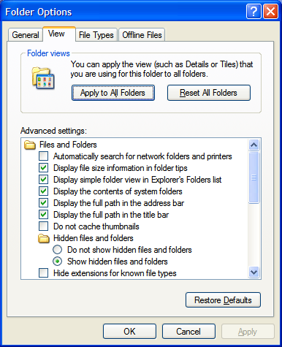
Disable Network Check
My Computer opens slowly
  Checks for network resources
    Printers
    File Shares
    Computers
Disable network check
  Open My Computer
  Click “Tools” menu item
  Click Folder Options
  Click View tab
  Go to Advanced Settings
    Uncheck “Automatically Search for Network Folders and Printers”

Slide 68
A Word on Benchmarking:
Use 'whole system' performance benchmarks
Artificial benchmarking programs are a great way to see the relative performance increase that your tweaks and changes have achieved. Running a benchmark before and after a prospective change will give you a good idea of where you stand.
Several companies produce 'whole system benchmarks' designed to stress test every area of your PC's performance and give you a result which you can use as a benchmark for improving your system's speed.
Try PCMark 2004 by Futuremark, SiSoftware's Sandra 2004 and Veritest's Winbench 99. In addition to benchmarking, these applications can also provide valuable information about your PC and its configuration.

Slide 69
The “Hidden” Applications in Add/Remove Programs
What is it?
  Uninstall unwanted Windows Components
How
  c:\windows\inf\sysoc.inf
  Remove the word "hide“
  Go to Add/Remove Windows Components
  Uninstall

